Slide 1
Chapter 5 Loops
Liang, Introduction to Java Programming, Tenth Edition, (c) 2015 Pearson Education, Inc. All rights reserved.

Slide 2
Motivations
Suppose that you need to print a string (e.g., "Welcome to Java!") a hundred times. It would be tedious to have to write the following statement a hundred times:
System.out.println("Welcome to Java!");
So, how do you solve this problem?

Slide 3
Opening Problem
Problem:
System.out.println("Welcome to Java!");
System.out.println("Welcome to Java!");
System.out.println("Welcome to Java!");
System.out.println("Welcome to Java!");
System.out.println("Welcome to Java!");
System.out.println("Welcome to Java!");
…
…
…
System.out.println("Welcome to Java!");
System.out.println("Welcome to Java!");
System.out.println("Welcome to Java!");
100 times

Slide 4
Introducing while Loops
int count = 0;
while (count < 100) {
System.out.println("Welcome to Java");
count++;
}

Slide 5
Objectives
To write programs for executing statements repeatedly using a while loop (§5.2).
To follow the loop design strategy to develop loops (§§5.2.1–5.2.3).
To control a loop with a sentinel value (§5.2.4).
To obtain large input from a file using input redirection rather than typing from the keyboard (§5.2.5).
To write loops using do-while statements (§5.3).
To write loops using for statements (§5.4).
To discover the similarities and differences of three types of loop statements (§5.5).
To write nested loops (§5.6).
To learn the techniques for minimizing numerical errors (§5.7).
To learn loops from a variety of examples (GCD, FutureTuition, Dec2Hex) (§5.8).
To implement program control with break and continue (§5.9).
To write a program that displays prime numbers (§5.11).
Liang, Introduction to Java Programming, Tenth Edition, (c) 2015 Pearson Education, Inc. All rights reserved.

Slide 6
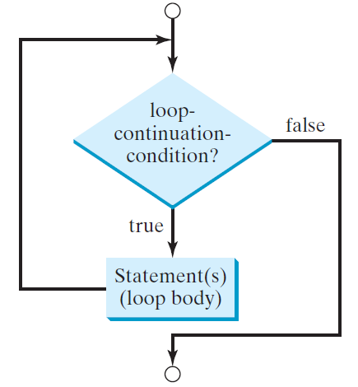
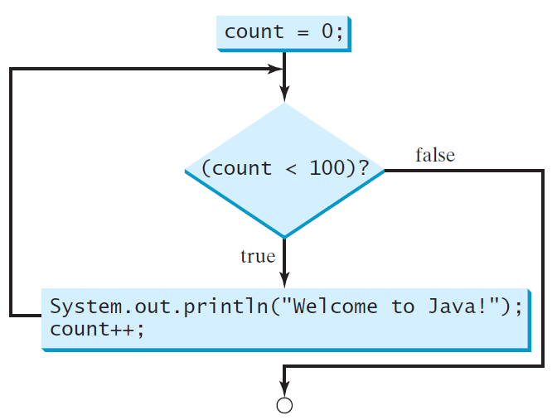
while Loop Flow Chart
int count = 0;
while (count < 100) {
System.out.println("Welcome to Java!");
count++;
}
while (loop-continuation-condition) {
// loop-body;
Statement(s);
}

Slide 7
Trace while Loop
animation
Initialize count
int count = 0;
while (count < 2) {
System.out.println("Welcome to Java!");
count++;
}

Slide 8
Trace while Loop, cont.
animation
(count < 2) is true
int count = 0;
while (count < 2) {
System.out.println("Welcome to Java!");
count++;
}

Slide 9
Trace while Loop, cont.
animation
Print Welcome to Java
int count = 0;
while (count < 2) {
System.out.println("Welcome to Java!");
count++;
}

Slide 10
Trace while Loop, cont.
animation
Increase count by 1
count is 1 now
int count = 0;
while (count < 2) {
System.out.println("Welcome to Java!");
count++;
}

Slide 11
Trace while Loop, cont.
animation
(count < 2) is still true since count is 1
int count = 0;
while (count < 2) {
System.out.println("Welcome to Java!");
count++;
}

Slide 12
Trace while Loop, cont.
animation
Print Welcome to Java
int count = 0;
while (count < 2) {
System.out.println("Welcome to Java!");
count++;
}

Slide 13
Trace while Loop, cont.
animation
Increase count by 1
count is 2 now
int count = 0;
while (count < 2) {
System.out.println("Welcome to Java!");
count++;
}

Slide 14
Trace while Loop, cont.
animation
(count < 2) is false since count is 2 now
int count = 0;
while (count < 2) {
System.out.println("Welcome to Java!");
count++;
}

Slide 15
Trace while Loop
animation
The loop exits. Execute the next statement after the loop.
int count = 0;
while (count < 2) {
System.out.println("Welcome to Java!");
count++;
}

Slide 16

Problem: Repeat Addition Until Correct
Recall that Listing 3.1 AdditionQuiz.java gives a program that prompts the user to enter an answer for a question on addition of two single digits. Using a loop, you can now rewrite the program to let the user enter a new answer until it is correct.
IMPORTANT NOTE: If you cannot run the buttons, see www.cs.armstrong.edu/liang/javaslidenote.doc.
RepeatAdditionQuiz

Slide 17
Problem: Guessing Numbers
Write a program that randomly generates an integer between 0 and 100, inclusive. The program prompts the user to enter a number continuously until the number matches the randomly generated number. For each user input, the program tells the user whether the input is too low or too high, so the user can choose the next input intelligently. Here is a sample run:
GuessNumberOneTime
GuessNumber

Slide 18

Problem: An Advanced Math Learning Tool
The Math subtraction learning tool program generates just one question for each run. You can use a loop to generate questions repeatedly. This example gives a program that generates five questions and reports the number of the correct answers after a student answers all five questions.
Animation
SubtractionQuizLoop

Slide 19
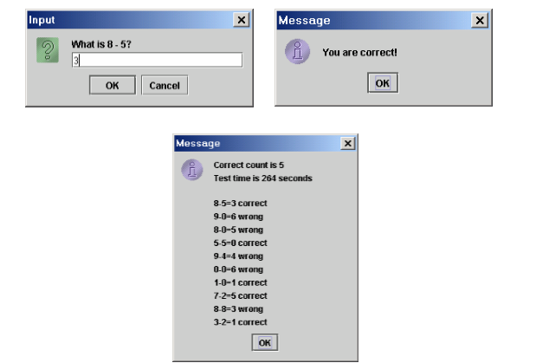

Slide 20
Ending a Loop with a Sentinel Value
Often the number of times a loop is executed is not predetermined. You may use an input value to signify the end of the loop. Such a value is known as a sentinel value.
Write a program that reads and calculates the sum of an unspecified number of integers. The input 0 signifies the end of the input.
SentinelValue

Slide 21
Caution
Don’t use floating-point values for equality checking in a loop control. Since floating-point values are approximations for some values, using them could result in imprecise counter values and inaccurate results. Consider the following code for computing 1 + 0.9 + 0.8 + ... + 0.1:
double item = 1; double sum = 0;
while (item != 0) { // No guarantee item will be 0
sum += item;
item -= 0.1;
}
System.out.println(sum);

Slide 22
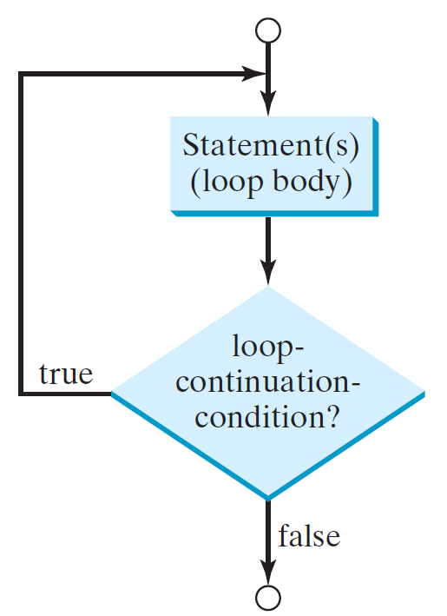
do-while Loop
do {
// Loop body;
Statement(s);
} while (loop-continuation-condition);

Slide 23
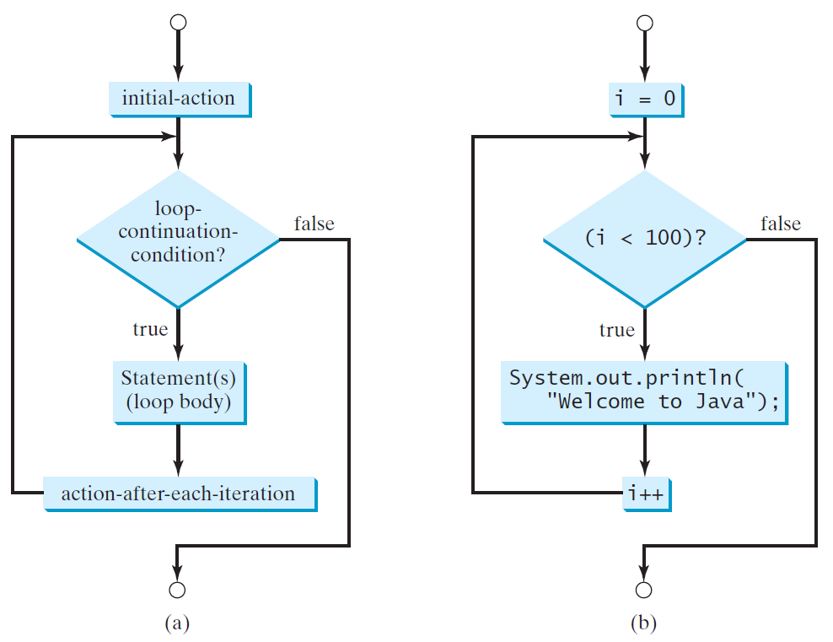
for Loops
for (initial-action; loop-continuation-condition; action-after-each-iteration) {
// loop body;
Statement(s);
}
int i;
for (i = 0; i < 100; i++) {
System.out.println(
"Welcome to Java!");
}

Slide 24
Trace for Loop
animation
Declare i
int i;
for (i = 0; i < 2; i++) {
System.out.println(
"Welcome to Java!");
}

Slide 25
Trace for Loop, cont.
animation
Execute initializer
i is now 0
int i;
for (i = 0; i < 2; i++) {
System.out.println(
"Welcome to Java!");
}

Slide 26
Trace for Loop, cont.
animation
(i < 2) is true
since i is 0
int i;
for (i = 0; i < 2; i++) {
System.out.println( "Welcome to Java!");
}

Slide 27
Trace for Loop, cont.
animation
Print Welcome to Java
int i;
for (i = 0; i < 2; i++) {
System.out.println("Welcome to Java!");
}

Slide 28
Trace for Loop, cont.
animation
Execute adjustment statement
i now is 1
int i;
for (i = 0; i < 2; i++) {
System.out.println("Welcome to Java!");
}

Slide 29
Trace for Loop, cont.
animation
(i < 2) is still true
since i is 1
int i;
for (i = 0; i < 2; i++) {
System.out.println("Welcome to Java!");
}

Slide 30
Trace for Loop, cont.
animation
Print Welcome to Java
int i;
for (i = 0; i < 2; i++) {
System.out.println("Welcome to Java!");
}

Slide 31
Trace for Loop, cont.
animation
Execute adjustment statement
i now is 2
int i;
for (i = 0; i < 2; i++) {
System.out.println("Welcome to Java!");
}

Slide 32
Trace for Loop, cont.
animation
(i < 2) is false
since i is 2
int i;
for (i = 0; i < 2; i++) {
System.out.println("Welcome to Java!");
}

Slide 33
Trace for Loop, cont.
animation
Exit the loop. Execute the next statement after the loop
int i;
for (i = 0; i < 2; i++) {
System.out.println("Welcome to Java!");
}

Slide 34
Note
The initial-action in a for loop can be a list of zero or more comma-separated expressions. The action-after-each-iteration in a for loop can be a list of zero or more comma-separated statements. Therefore, the following two for loops are correct. They are rarely used in practice, however.
  for (int i = 1; i < 100; System.out.println(i++));
  for (int i = 0, j = 0; (i + j < 10); i++, j++) {
  // Do something
  }

Slide 35

Note
If the loop-continuation-condition in a for loop is omitted, it is implicitly true. Thus the statement given below in (a), which is an infinite loop, is correct. Nevertheless, it is better to use the equivalent loop in (b) to avoid confusion:

Slide 36
Caution
Adding a semicolon at the end of the for clause before the loop body is a common mistake, as shown below:
Logic Error
for (int i=0; i<10; i++);
{
System.out.println("i is " + i);
}

Slide 37
Caution, cont.
Similarly, the following loop is also wrong:
int i=0;
while (i < 10);
{
System.out.println("i is " + i);
i++;
}
In the case of the do loop, the following semicolon is needed to end the loop.
int i=0;
do {
System.out.println("i is " + i);
i++;
} while (i<10);
Logic Error
Correct

Slide 38


Which Loop to Use?
The three forms of loop statements, while, do-while, and for, are expressively equivalent; that is, you can write a loop in any of these three forms. For example, a while loop in (a) in the following figure can always be converted into the following for loop in (b):
A for loop in (a) in the following figure can generally be converted into the following while loop in (b) except in certain special cases (see Review Question 3.19 for one of them):

Slide 39
Recommendations
Use the one that is most intuitive and comfortable for you. In general, a for loop may be used if the number of repetitions is known, as, for example, when you need to print a message 100 times. A while loop may be used if the number of repetitions is not known, as in the case of reading the numbers until the input is 0. A do-while loop can be used to replace a while loop if the loop body has to be executed before testing the continuation condition.

Slide 40
Nested Loops
Problem: Write a program that uses nested for loops to print a multiplication table.
MultiplicationTable

Slide 41
Minimizing Numerical Errors
Numeric errors involving floating-point numbers are inevitable. This section discusses how to minimize such errors through an example.
Here is an example that sums a series that starts with 0.01 and ends with 1.0. The numbers in the series will increment by 0.01, as follows: 0.01 + 0.02 + 0.03 and so on.
TestSum

Slide 42
Problem:
Finding the Greatest Common Divisor
Problem: Write a program that prompts the user to enter two positive integers and finds their greatest common divisor.
Solution: Suppose you enter two integers 4 and 2, their greatest common divisor is 2. Suppose you enter two integers 16 and 24, their greatest common divisor is 8. So, how do you find the greatest common divisor? Let the two input integers be n1 and n2. You know number 1 is a common divisor, but it may not be the greatest commons divisor. So you can check whether k (for k = 2, 3, 4, and so on) is a common divisor for n1 and n2, until k is greater than n1 or n2.
GreatestCommonDivisor
Run

Slide 43
Problem: Predicting the Future Tuition
Problem: Suppose that the tuition for a university is $10,000 this year and tuition increases 7% every year. In how many years will the tuition be doubled?
FutureTuition
Run

Slide 44
Problem: Predicating the Future Tuition
double tuition = 10000; int year = 0 // Year 0
tuition = tuition * 1.07; year++; // Year 1
tuition = tuition * 1.07; year++; // Year 2
tuition = tuition * 1.07; year++; // Year 3
...

Slide 45
Case Study: Converting Decimals to Hexadecimals
Hexadecimals are often used in computer systems programming (see Appendix F for an introduction to number systems). How do you convert a decimal number to a hexadecimal number? To convert a decimal number d to a hexadecimal number is to find the hexadecimal digits h_{n}, h_{n-1}, h_{n-2}, ... , h₂, h₁, and h₀ such that
These hexadecimal digits can be found by successively dividing d by 16 until the quotient is 0. The remainders are h₀, h₁, h₂, ... , h_{n-2}, h_{n-1}, and h_{n}.
Dec2Hex
Run

Slide 46

Problem: Monte Carlo Simulation
Companion Website
The Monte Carlo simulation refers to a technique that uses random numbers and probability to solve problems. This method has a wide range of applications in computational mathematics, physics, chemistry, and finance. This section gives an example of using the Monto Carlo simulation for estimating π.
circleArea / squareArea = π / 4.
π can be approximated as 4 * numberOfHits / numberOfTrials
MonteCarloSimulation
Run

Slide 47
Using break and continue
Examples for using the break and continue keywords:
TestBreak.java
TestBreak
TestContinue.java
TestContinue

Slide 48
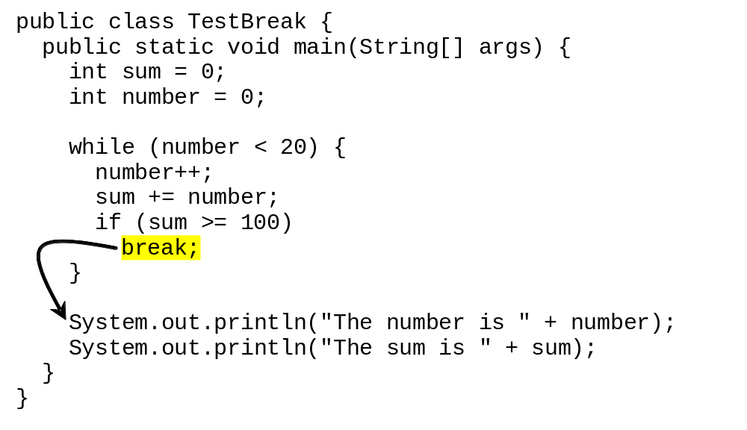
break

Slide 49
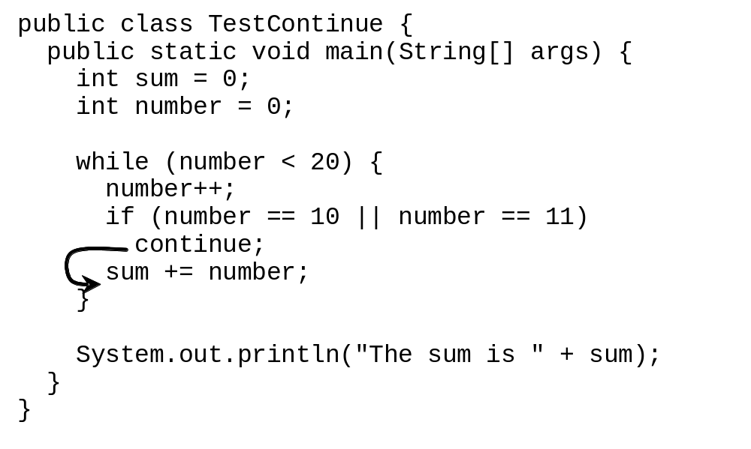
continue

Slide 50
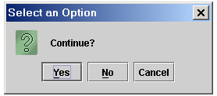
Controlling a Loop with a Confirmation Dialog
int option = 0;
while (option == JOptionPane.YES_OPTION)
{ System.out.println("continue loop");
option = JOptionPane.showConfirmDialog(null, "Continue?"); }
The value is
JOptionPane.YES_OPTION (0) for Yes button,
JOptionPane.NO_OPTION (1) for the No button, and
JOptionPane.CANCEL_OPTION (2) for Cancel button.

Slide 51
Guessing Number Problem Revisited
Here is a program for guessing a number. You can rewrite it using a break statement.
GuessNumberUsingBreak

Slide 52
Problem: Displaying Prime Numbers
Problem: Write a program that displays the first 50 prime numbers in five lines, each of which contains 10 numbers. An integer greater than 1 is prime if its only positive divisor is 1 or itself. For example, 2, 3, 5, and 7 are prime numbers, but 4, 6, 8, and 9 are not.
Solution: The problem can be broken into the following tasks:
  For number = 2, 3, 4, 5, 6, ..., test whether the number is prime.
  Determine whether a given number is prime.
  Count the prime numbers.
  Print each prime number, and print 10 numbers per line.
PrimeNumber
Run

Slide 53
Debugging Loops in IDE Tools
Companion Website
Supplements II.C, II.E, and II.G.

